Slide 1
Shallow and Deep Cloning

Slide 2
Shallow cloning

Slide 3
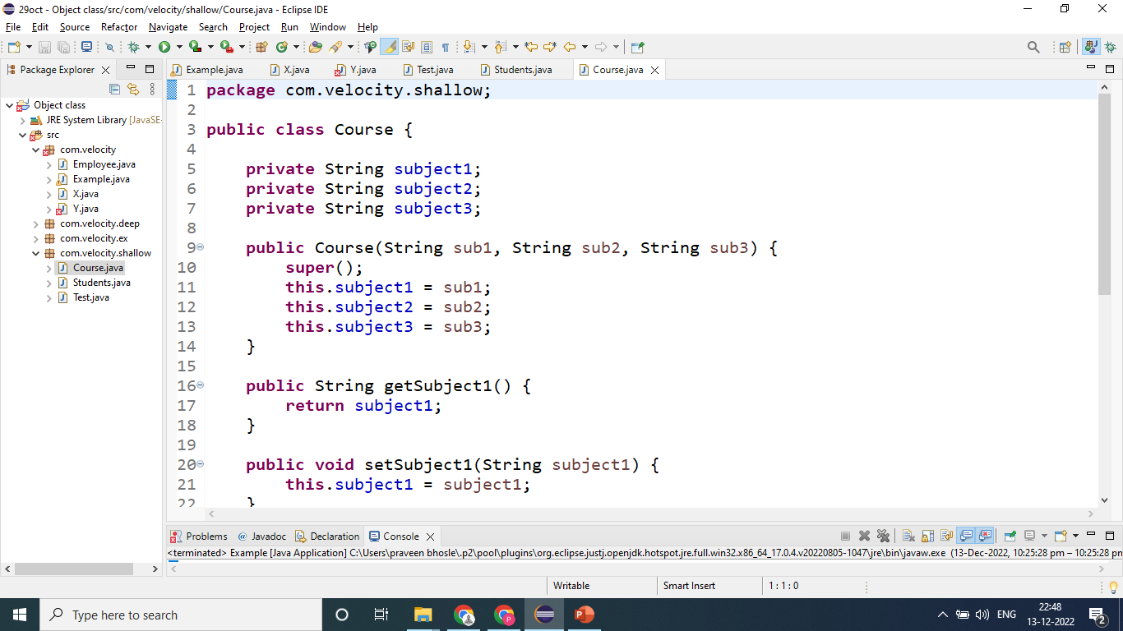

Slide 4
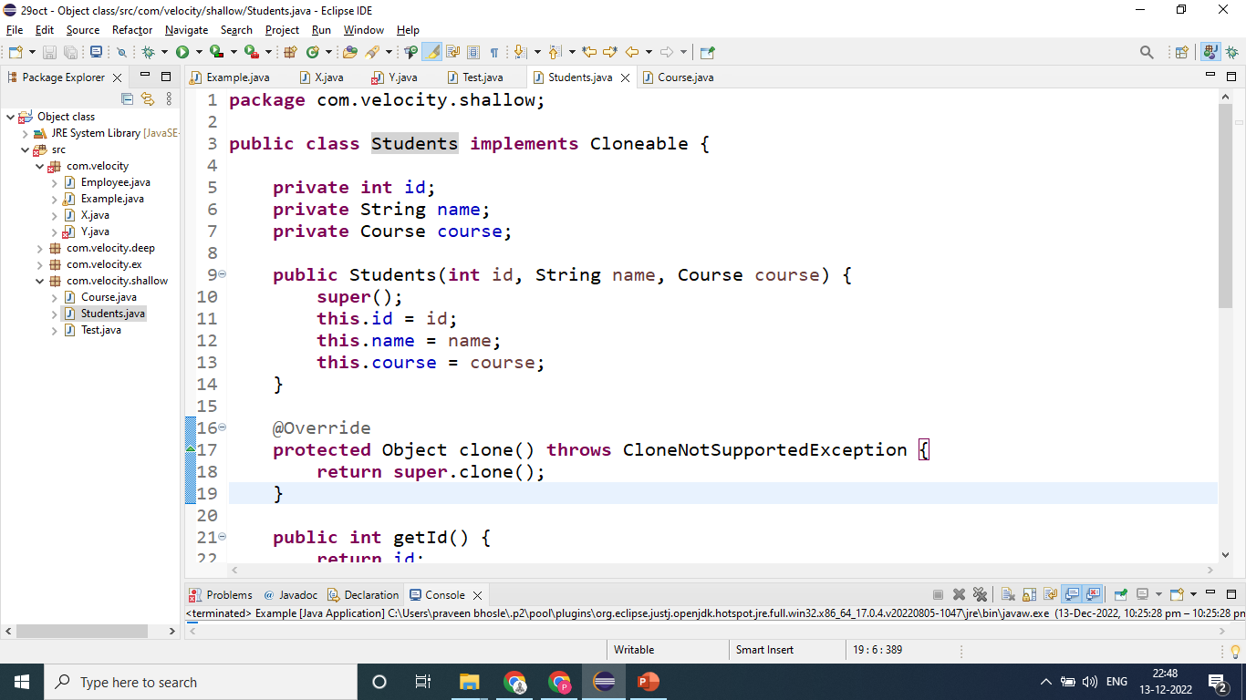

Slide 5
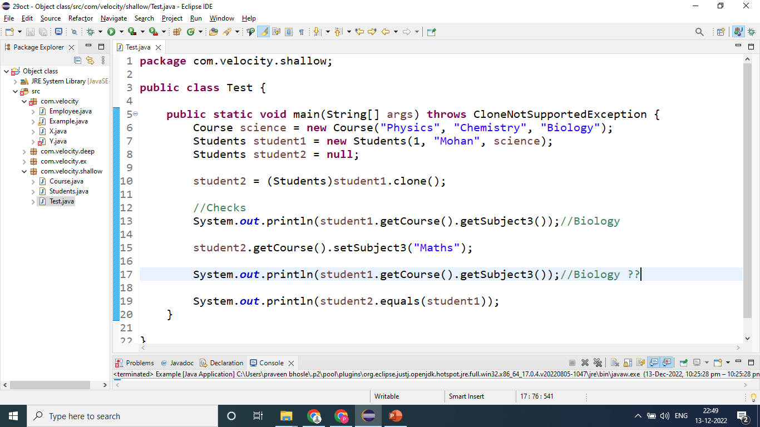

Slide 6
Deep cloning

Slide 7
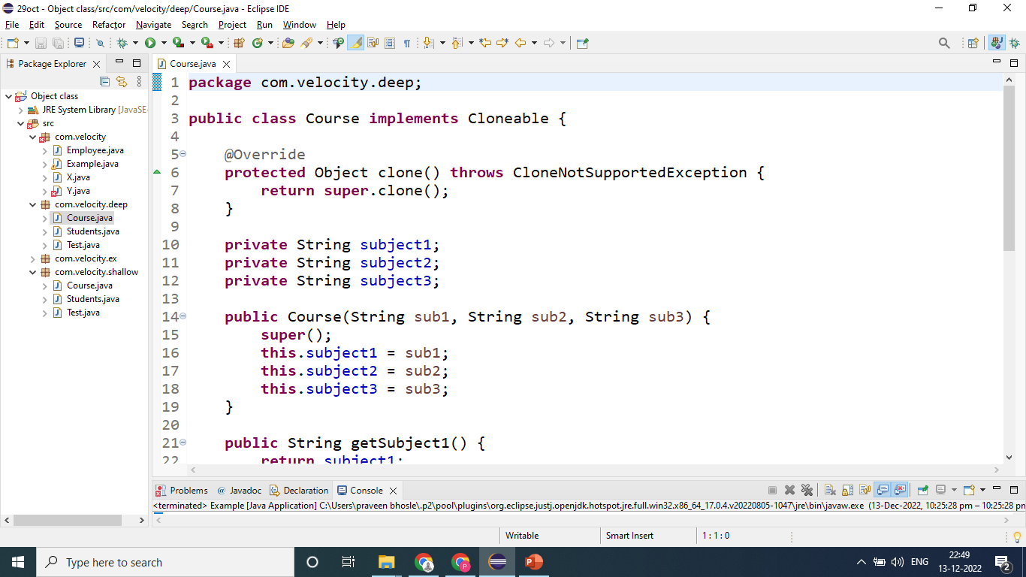

Slide 8
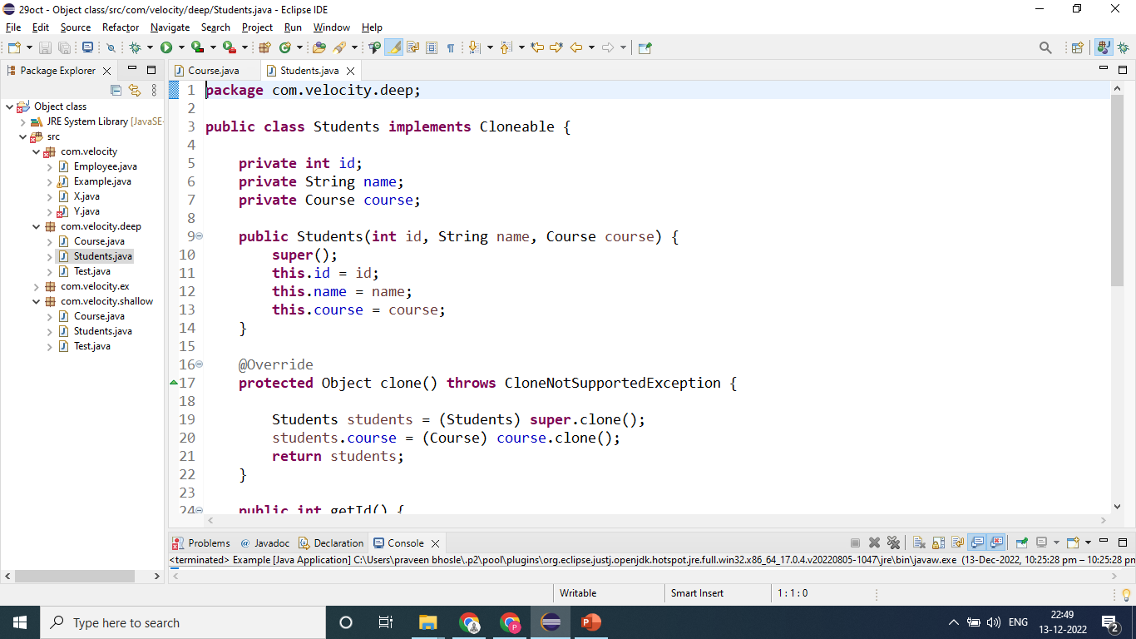

Slide 9
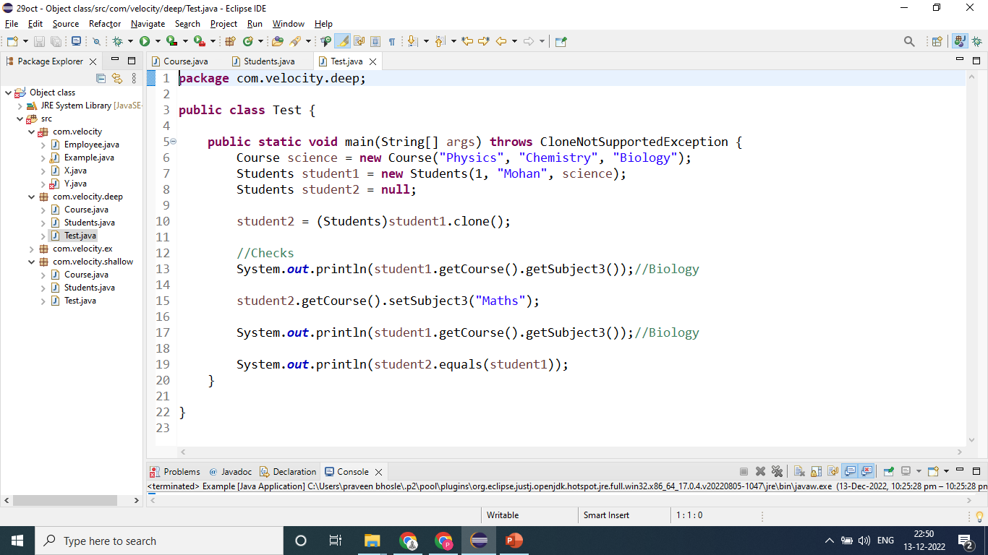

Slide 10
Thank You

